Slide 1
Course Overview
CSCI 601-471/671 (NLP: Self-Supervised Models)
https://self-supervised.cs.jhu.edu/sp2024/

Slide 2

Why This Course?
Let’s start with an example: ChatGPT
A computational model that respond to dialogue commands.
https://chat.openai.com/chat

Slide 3
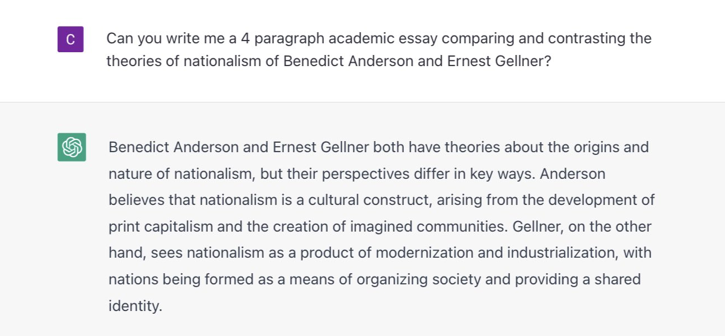
An Example
Let’s start with an example: ChatGPT
https://chat.openai.com/chat

Slide 4
An Example
Can write essays, expand an idea, summarize documents, translate them, debug your code, explain it, suggest improvements, etc.
How is it able to do these? 🤔
What are the principles that govern this technology?
Can we replicate it?
Can we extend it?

Slide 5
Meanwhile …

Slide 6
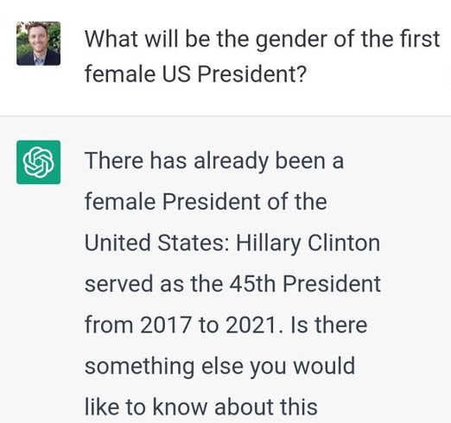
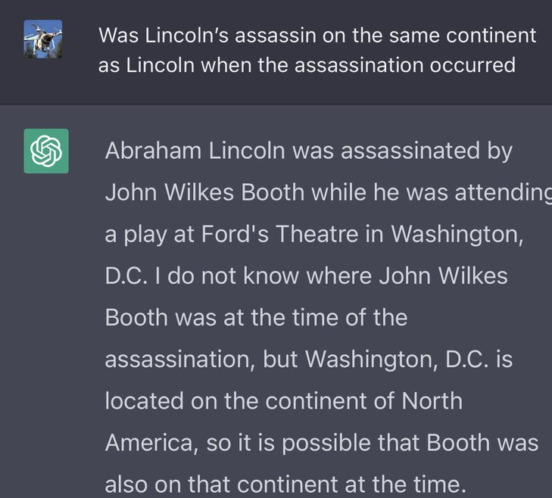

Slide 7
Why This Course?
The model is extremely good at important tasks that we can about: why? how?
It is easily fails at seemingly trivial tasks: why?
Why does it make such surprisingly simple mistakes? 🤔
Can we explain these?
Can we predict them?
Can we mitigate (or even better, solve) them?

Slide 8
Course Learning Objectives
Learn about architectures that serve as foundation for tools like ChatGPT
Understand a wide range of self-supervised algorithms
Fearlessly build and train self-supervised models 😤
Gain intuitions about the capabilities and limitations of our models
Reflect on societal impacts: their misuse, biases, etc.

Slide 9
Focus on Natural/Human Language
Most of the class revolves around natural language.
Why natural language?
It is a convenient medium of communication.
Natural language is our species’ best attempt to encode everything about the world as efficiently as possible.
A huge archive of natural language is freely available (e.g., on the web).

Slide 10
Self-Supervised Models

Slide 11
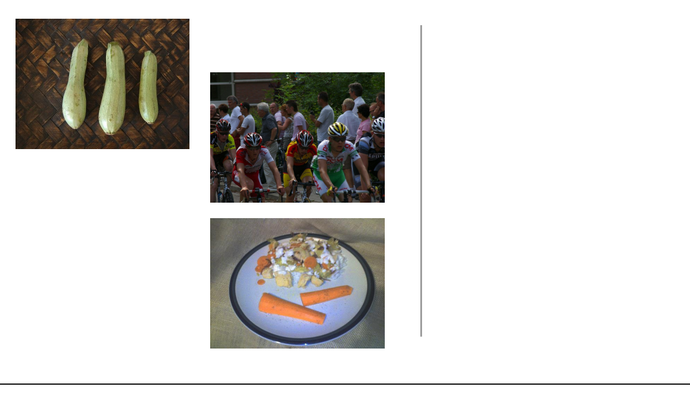
Self-Supervision
[Slide credit: Colin Raffel]

Slide 12
Self-Supervision
[Slide credit: Colin Raffel]

Slide 13
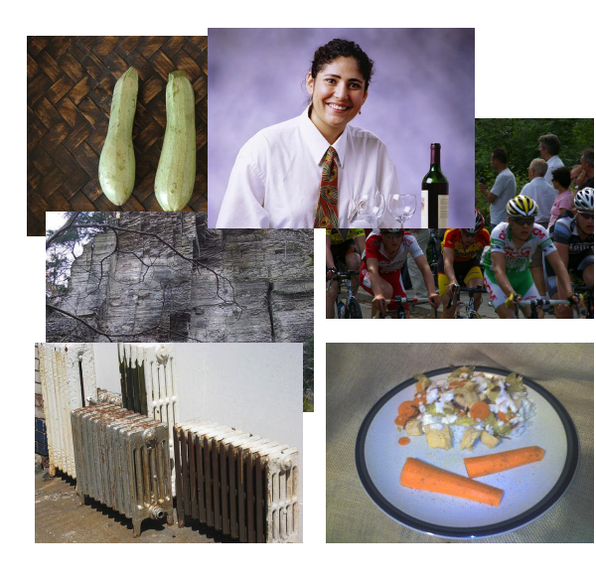
Self-Supervision
[Slide credit: Colin Raffel]

Slide 14
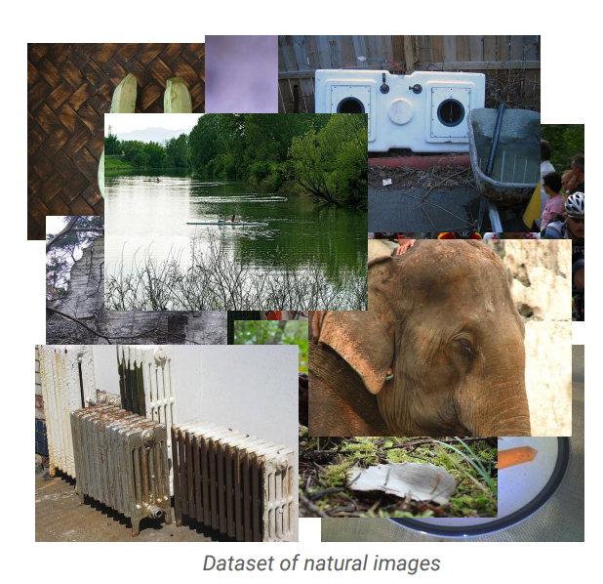
Self-Supervision
[Slide credit: Colin Raffel]

Slide 15
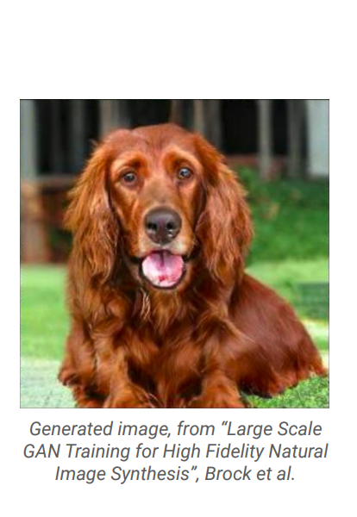
Self-Supervision
[Slide credit: Colin Raffel]

Slide 16
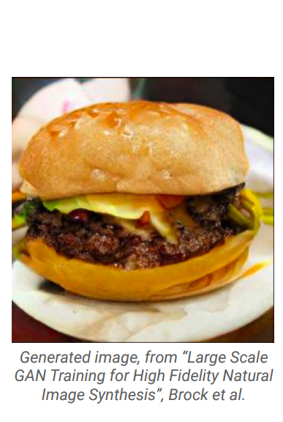
Self-Supervision
[Slide credit: Colin Raffel]

Slide 17
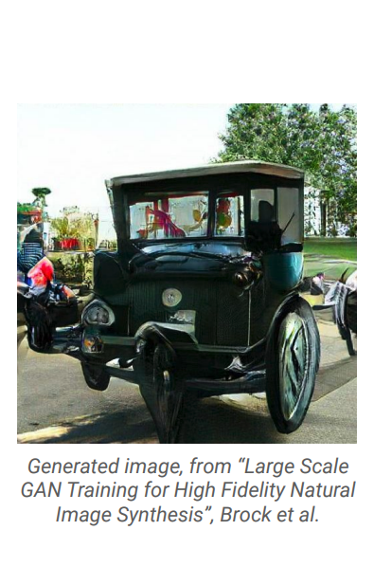
Self-Supervision
[Slide credit: Colin Raffel]

Slide 18
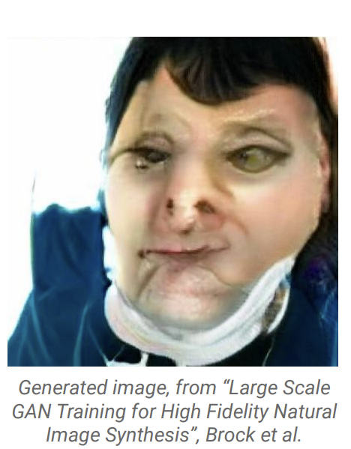
Self-Supervision
[Slide credit: Colin Raffel]

Slide 19
Self-Supervision
== treaty of paris (1763) the treaty of paris, also known as the treaty of 1763, was signed on 10 february 1763 by the kingdoms of great britain, france and spain, with portugal in agreement, after great britain's victory over france and spain during the seven years' war. the signing of the treaty formally ended the seven years' war, known as the french and indian war in the north american theatre, ….
[Slide credit: Colin Raffel]

Slide 20
Self-Supervision
== wheelbarrow
A wheelbarrow is a small hand-propelled vehicle, usually with just one wheel, designed to be pushed and guided by a single person using two handles at the rear, or by a sail to push the ancient wheelbarrow by wind. The term "wheelbarrow" is made of two words: "wheel" and "barrow." "Barrow" is a derivation of the Old English "barew" which was a device used for carrying loads. The wheelbarrow is designed to …..
== treaty of paris (1763) the treaty of paris, also known as the treaty of 1763, was signed on 10 february 1763 by the kingdoms of great britain, france and spain, with portugal in agreement, after great britain's victory over france and spain during the seven years' war. the signing of the treaty formally ended the seven years' war, known as the french and indian war in the north american theatre, ….
[Slide credit: Colin Raffel]

Slide 21

Self-Supervision
== lemon
The lemon (Citrus limon) is a species of small evergreen trees in the flowering plant family Rutaceae, native to Asia, primarily Northeast India (Assam), Northern Myanmar or China.[2] The tree's ellipsoidal yellow fruit is used for culinary and non-culinary purposes throughout the world, primarily for its juice, which has both culinary and cleaning uses.[2] The pulp and rind are also used in cooking and baking. ….
== wheelbarrow
A wheelbarrow is a small hand-propelled vehicle, usually with just one wheel, designed to be pushed and guided by a single person using two handles at the rear, or by a sail to push the ancient wheelbarrow by wind. The term "wheelbarrow" is made of two words: "wheel" and "barrow." "Barrow" is a derivation of the Old English "barew" which was a device used for carrying loads. The wheelbarrow is designed to …..
== treaty of paris (1763) the treaty of paris, also known as the treaty of 1763, was signed on 10 february 1763 by the kingdoms of great britain, france and spain, with portugal in agreement, after great britain's victory over france and spain during the seven years' war. the signing of the treaty formally ended the seven years' war, known as the french and indian war in the north american theatre, ….
Dataset of Wikipedia articles
[Slide credit: Colin Raffel]

Slide 22
Self-Supervision
== lemon
The lemon (Citrus limon) is a species of small evergreen trees in the flowering plant family Rutaceae, native to Asia, primarily Northeast India (Assam), Northern Myanmar or China.[2] The tree's ellipsoidal yellow fruit is used for culinary and non-culinary purposes throughout the world, primarily for its juice, which has both culinary and cleaning uses.[2] The pulp and rind are also used in cooking and baking. ….
== wheelbarrow
A wheelbarrow is a small hand-propelled vehicle, usually with just one wheel, designed to be pushed and guided by a single person using two handles at the rear, or by a sail to push the ancient wheelbarrow by wind. The term "wheelbarrow" is made of two words: "wheel" and "barrow." "Barrow" is a derivation of the Old English "barew" which was a device used for carrying loads. The wheelbarrow is designed to …..
== wings over kansas wings over kansas is the second studio album by jason ammons, john bolster and mo rosato. the album debuted at number one on the billboard 200, selling 35,000 copies in it first week at the time. it was the second highest selling album to debut at the billboard top 50 and the third highest selling album to debut at the top heatseekers, with 26,000 copies sold. this is the supremes album earning the nickname …
== treaty of paris (1763) the treaty of paris, also known as the treaty of 1763, was signed on 10 february 1763 by the kingdoms of great britain, france and spain, with portugal in agreement, after great britain's victory over france and spain during the seven years' war. the signing of the treaty formally ended the seven years' war, known as the french and indian war in the north american theatre, ….
Dataset of Wikipedia articles
[Slide credit: Colin Raffel]

Slide 23
Self-Supervised Models
are predictive models of the world!

Slide 24
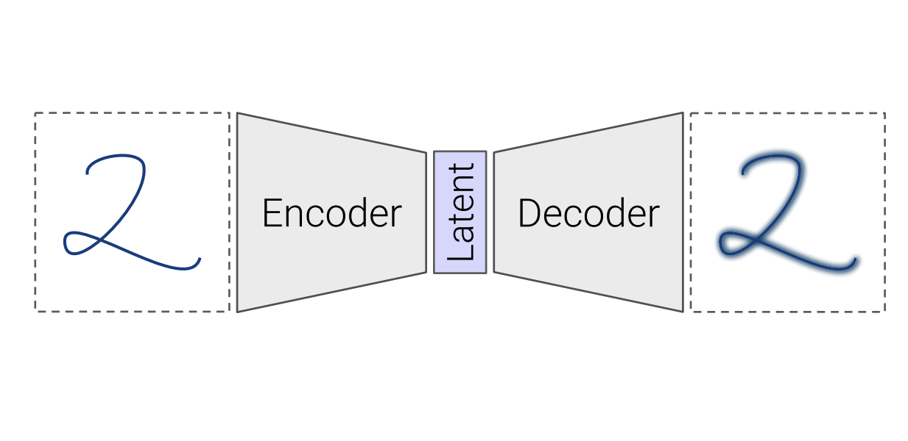
Self-Supervised Models
are predictive models of the world!
Are trained to complete partial samples from the world.
Mask
[Bengio et al. 2004, Hinton et al. 2006, Peters et al. 2018, …]

Slide 25
Self-Supervised Models
are predictive models of the world!
Are trained to complete partial samples from the world.
“Wings over Kansas is an aviation website founded in 1998 by Carl Chance owned by Chance Communications, Inc.”
“Wings over Kansas is [MASK]”
[Bengio et al. 2004, Hinton et al. 2006, Peters et al. 2018, …]

Slide 26
Self-Supervised Models
are predictive models of the world!
learned from cheaply available unlabeled data

Slide 27
Self-Supervised Models
are predictive models of the world!
learned from cheaply available unlabeled data

Slide 28
Self-Supervised Models
are tightly connected to tasks we care about.
Goal: Answering questions
Question: “Where is the birthplace of the American national anthem?”
✍️
“The birthplace of the American national anthem, "The Star-Spangled Banner," lies in Baltimore, Maryland.”
“The birthplace of the American national anthem” [MASK]
Produced with GPT-J: https://6b.eleuther.ai/

Slide 29
Self-Supervised Models
Are predictive models of the world.
Are learned from unlabeled data.
Tightly connected to tasks we care about.

Slide 30
How did we get here?

Slide 31
Progress in AI
Many advances are due to neural networks
How old are neural networks?
[Slide credit: Arman Cohan]

Slide 32
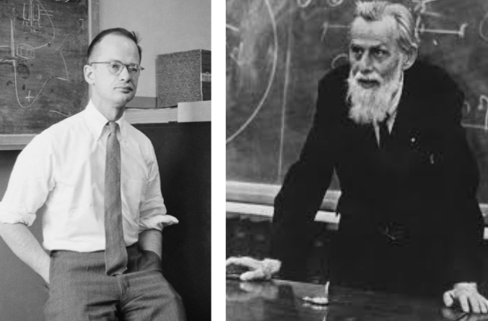
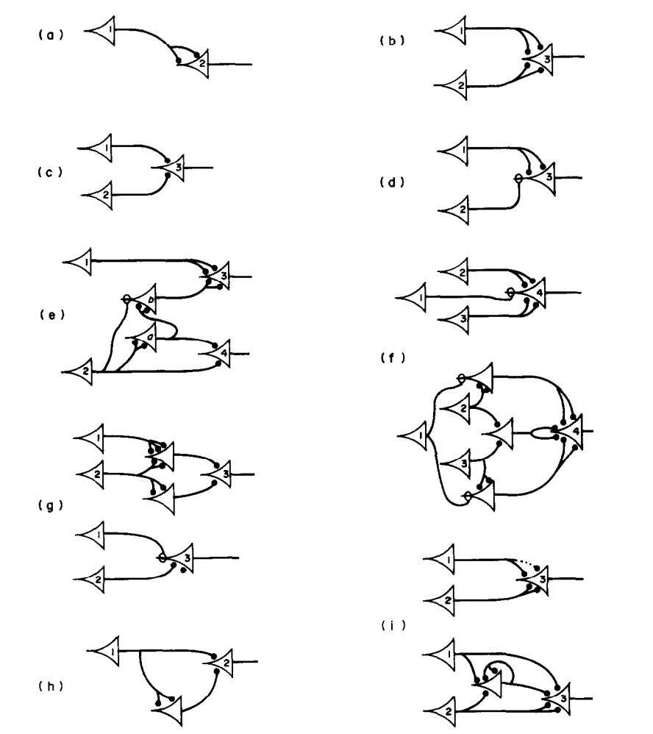
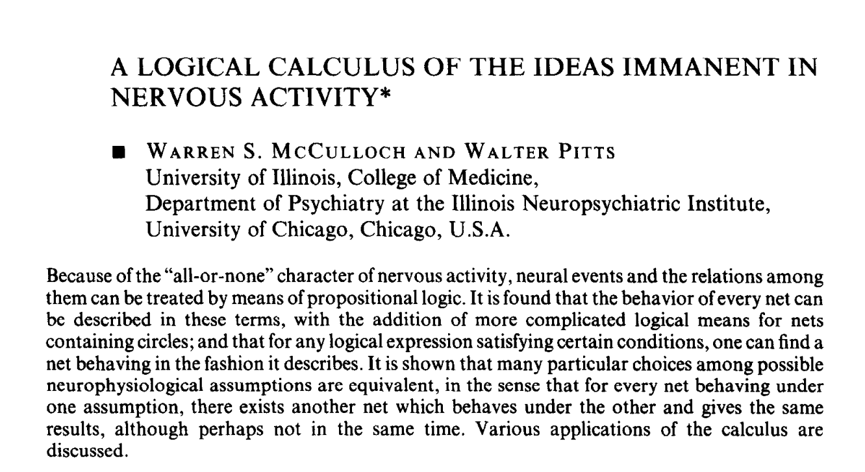
Progress in AI
Many advances are due to neural networks
How old are neural networks?
McCulloch & Pitts (1943)
[Slide credit: Arman Cohan]

Slide 33
Progress in AI
Many advances are due to neural networks
How old are neural networks?
They’ve been around since the 1940s
But why have only recently we seen breakthroughs?
3 forces came together!
[Slide credit: Arman Cohan]

Slide 34

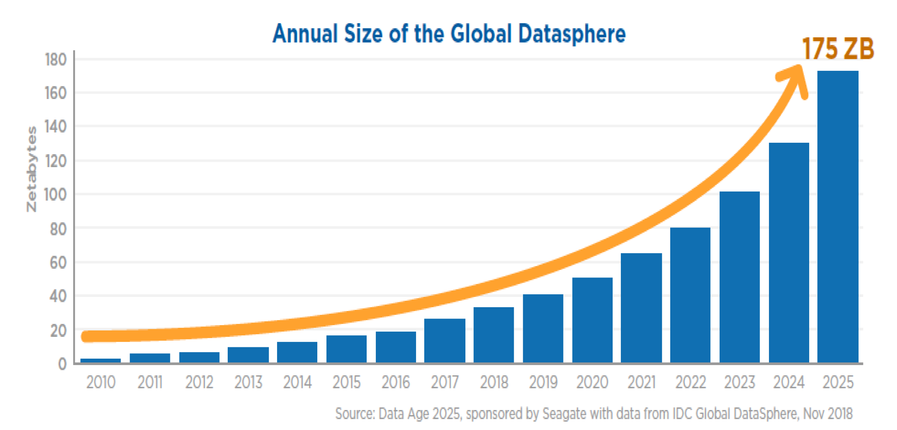
Force 1: Massive Amount of Data
Internet provided us with a massive repository of data.
Image source: https://www.forbes.com/sites/tomcoughlin/2018/11/27/175-zettabytes-by-2025/?sh=1e6ca8455459

Slide 35
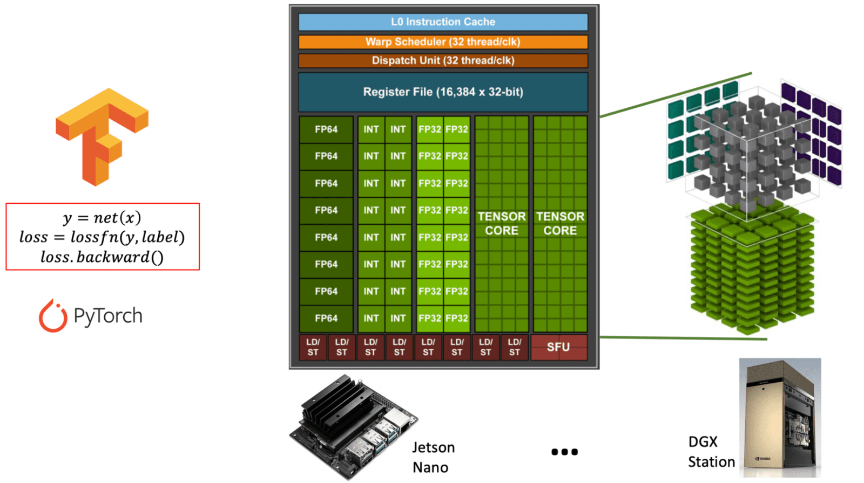
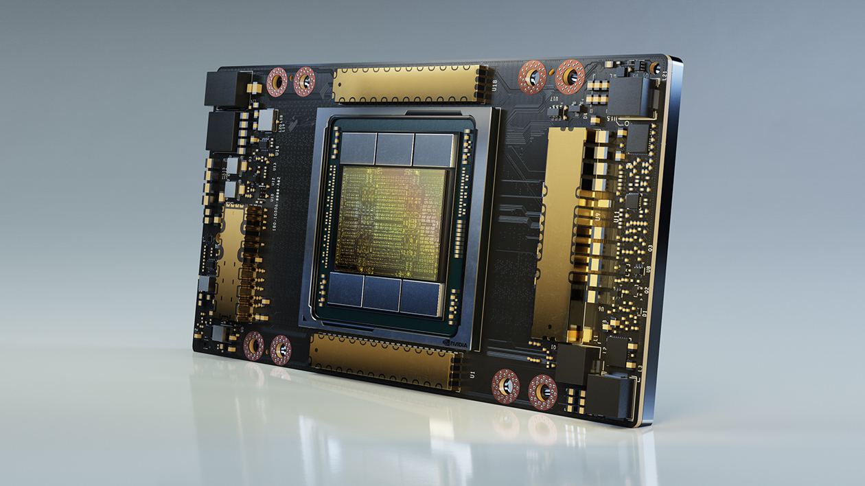
Force 2: Computing Power
Fast processors for deep learning!
A100 GPU

Slide 36
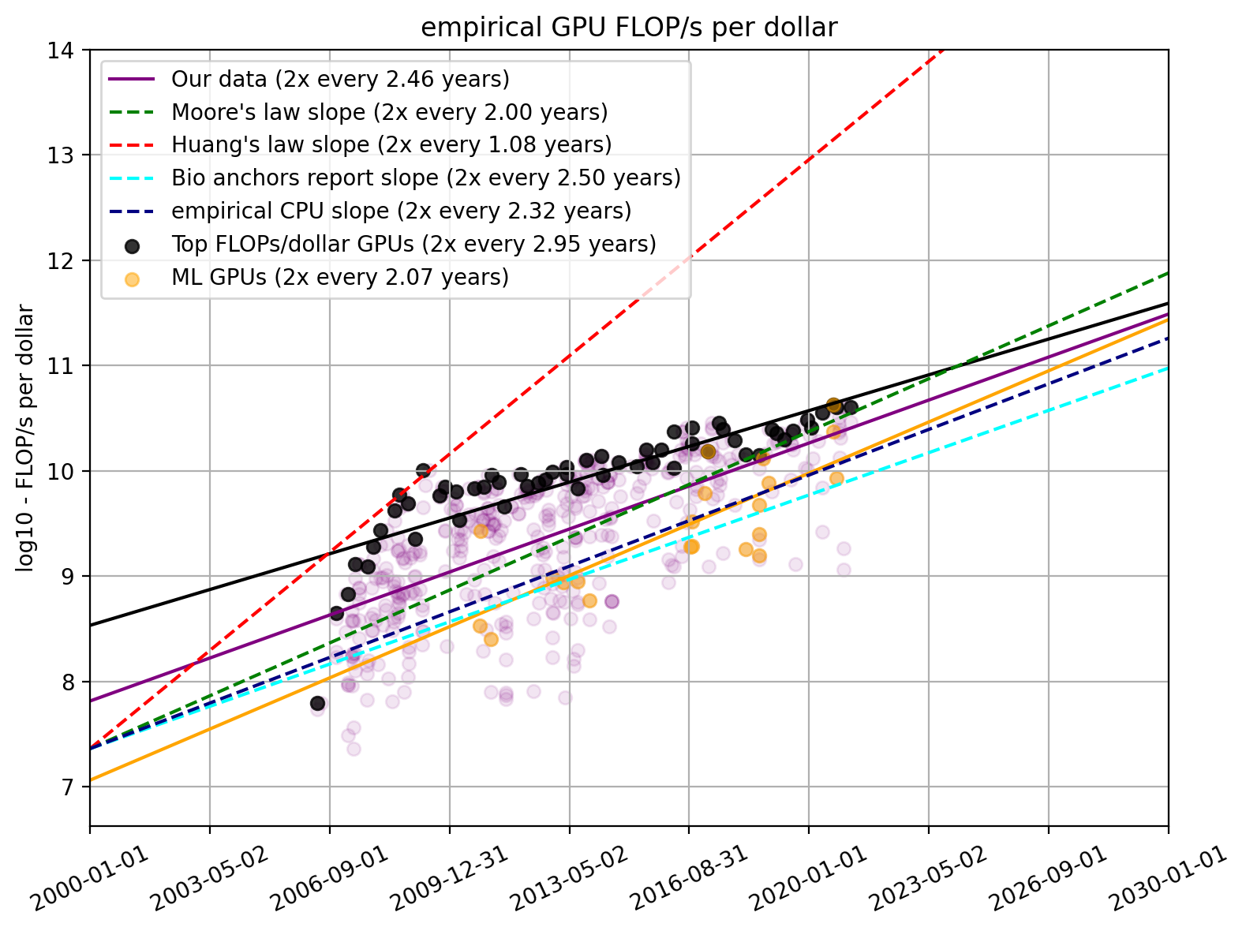
Force 2: Computing Power
Fast processors for deep learning!
Cheaper computing power over time.
The amount of computing power, per dollar
https://www.lesswrong.com/posts/c6KFvQcZggQKZzxr9/trends-in-gpu-price-performance

Slide 37
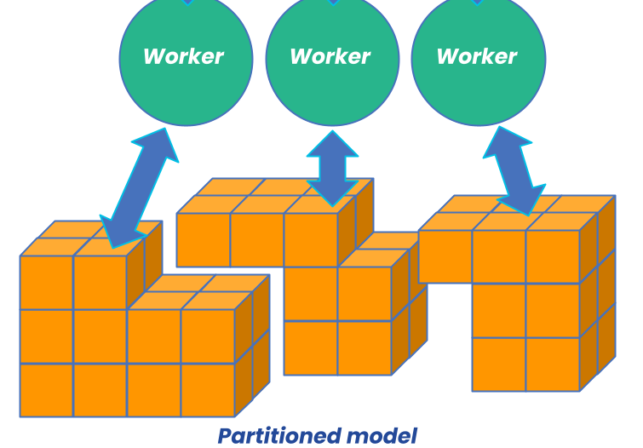
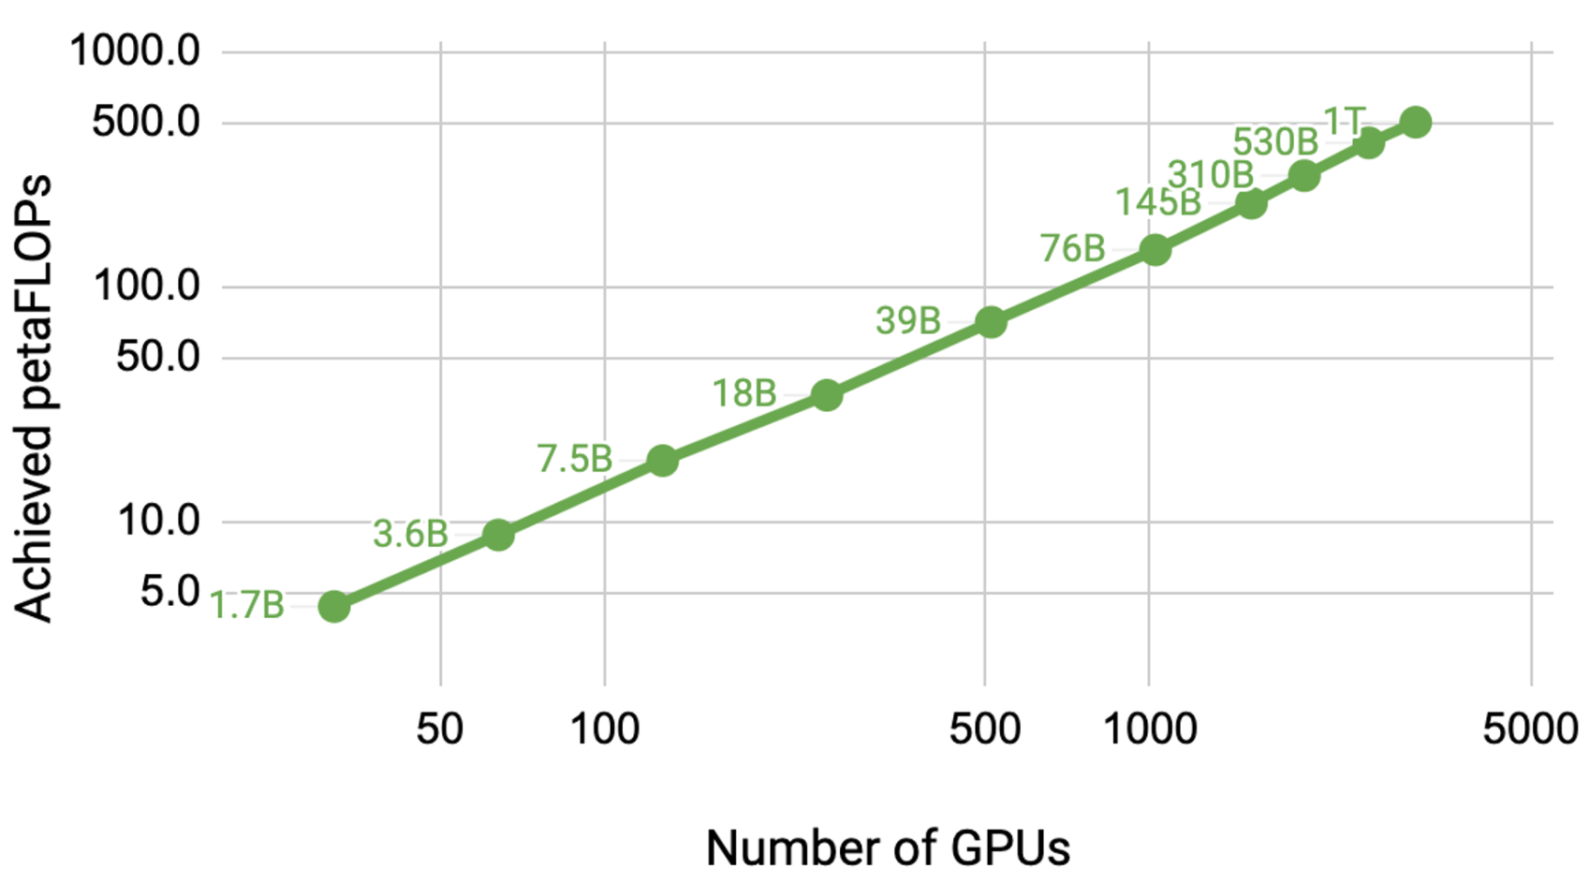
Force 2: Computing Power
Fast processors for deep learning!
Cheaper computing power over time.
Distributed training/inference allows us to scale to a larger set of processors.
Image source: https://developer.nvidia.com/blog/scaling-language-model-training-to-a-trillion-parameters-using-megatron/

Slide 38
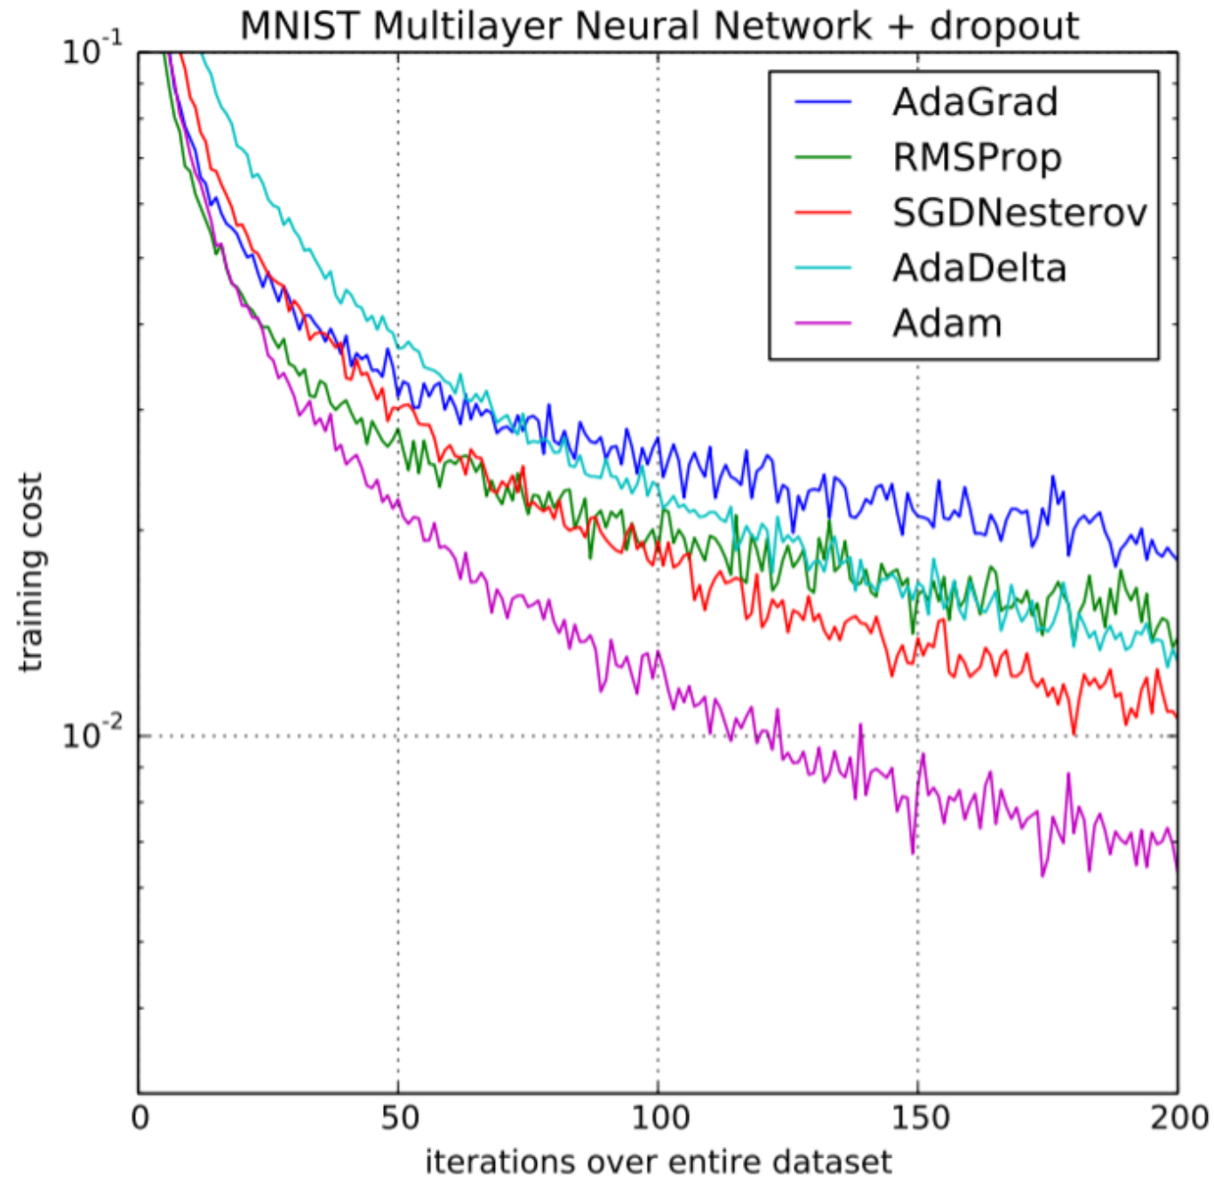
Force 3: Algorithmic innovations
Advances in optimization

Slide 39
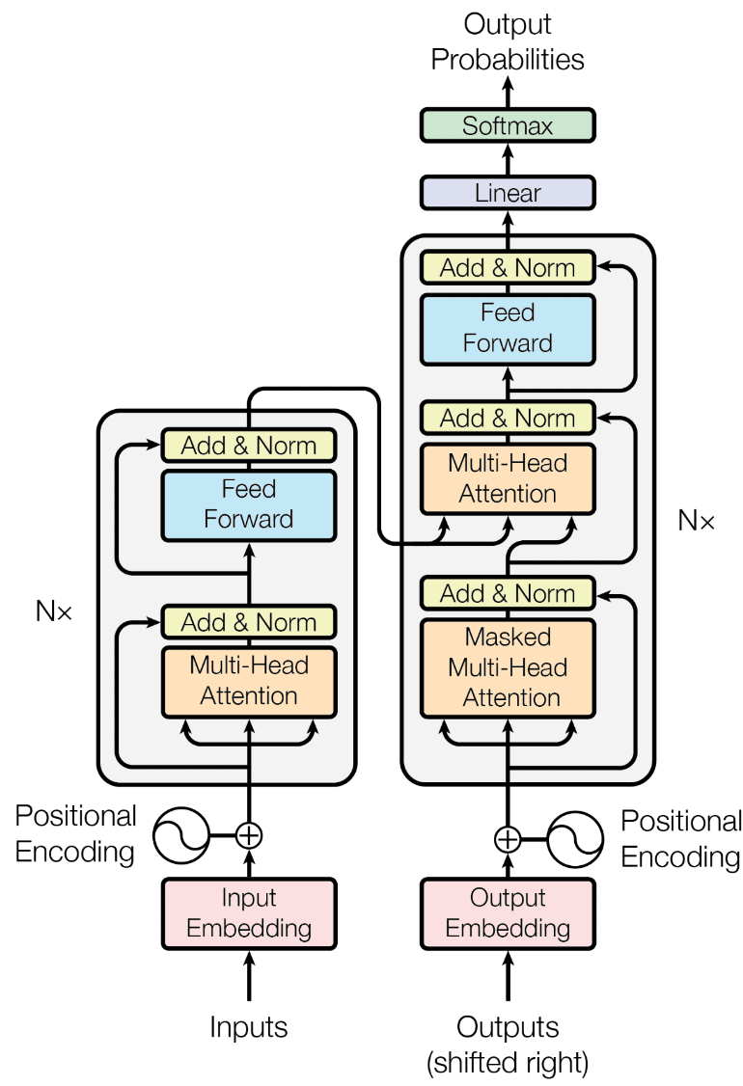
Force 3: Algorithmic innovations
Advances in optimization
Innovations in model architectures
….

Slide 40

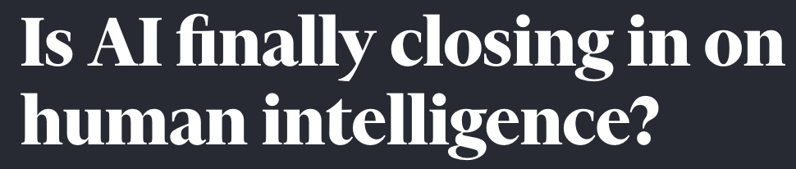


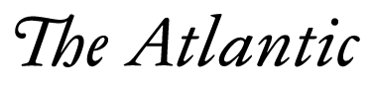
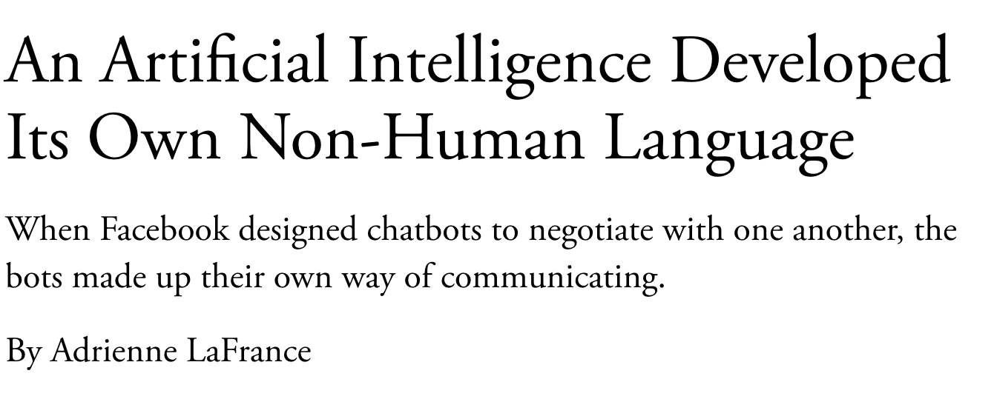
Self-Supervised Models

Slide 41
On terminology
These names are sometimes used interchangeably:
Self-supervised models
Pre-trained models
Generative AI models
Foundation models
Frontier models
…
Though they’re not exactly the same.

Slide 42
On terminology
These names are sometimes used interchangeably:
Self-supervised models
Pre-trained models
Generative AI models
Foundation models
Frontier models
…
Though they’re not exactly the same.
~ Models that generate content

Slide 43
On terminology
These names are sometimes used interchangeably:
Self-supervised models
Pre-trained models
Generative AI models
Foundation models
Frontier models
…
Though they’re not exactly the same.
~ can be used as a foundational component of modern AI systems
That doesn’t mean that these models are the foundation of AI!
More discussion on naming (Bommasani et al., 2021) https://arxiv.org/pdf/2108.07258.pdf

Slide 44
On terminology
These names are sometimes used interchangeably:
Self-supervised models
Pre-trained models
Generative AI models
Foundation models
Frontier models
…
Though they’re not exactly the same.
We will see it!

Slide 45
On terminology
These names are sometimes used interchangeably:
Self-supervised models
Pre-trained models
Generative AI models
Foundation models
Frontier models
…
Which is your favorite? 😊

Slide 46
ML
Deep learning
Self-supervised models
Generative AI
LLMs
[Slide credit: Arman Cohan]

Slide 47
Current state of Self-supervised Models
Almost every AI model is based on Neural networks
Performance is consistently improving with scale
More training data
Larger models (number of neural network parameters)
[Slide credit: Arman Cohan]

Slide 48
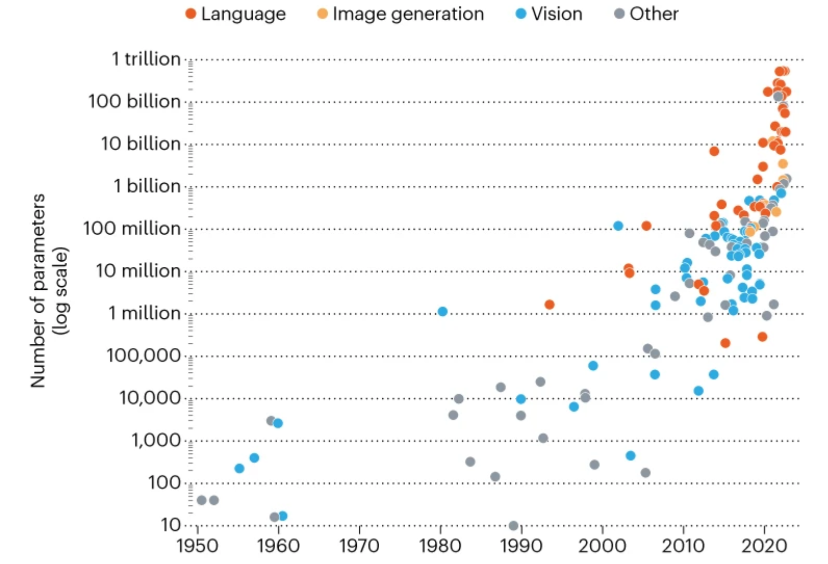
Current state of Self-supervised Models
State-of-the-art models are hundreds of billions of parameters
Image from: In AI, is bigger always better? https://www.nature.com/articles/d41586-023-00641-w
[Slide credit: Arman Cohan]

Slide 49



Current state of Self-supervised Models
PALM
State-of-the-art models are hundreds of billions of parameters
Trained on vast amounts of data (Trillions of tokens)
GPT-3
LLAMA
Image from: In AI, is bigger always better? https://www.nature.com/articles/d41586-023-00641-w
[Slide credit: Arman Cohan]

Slide 50
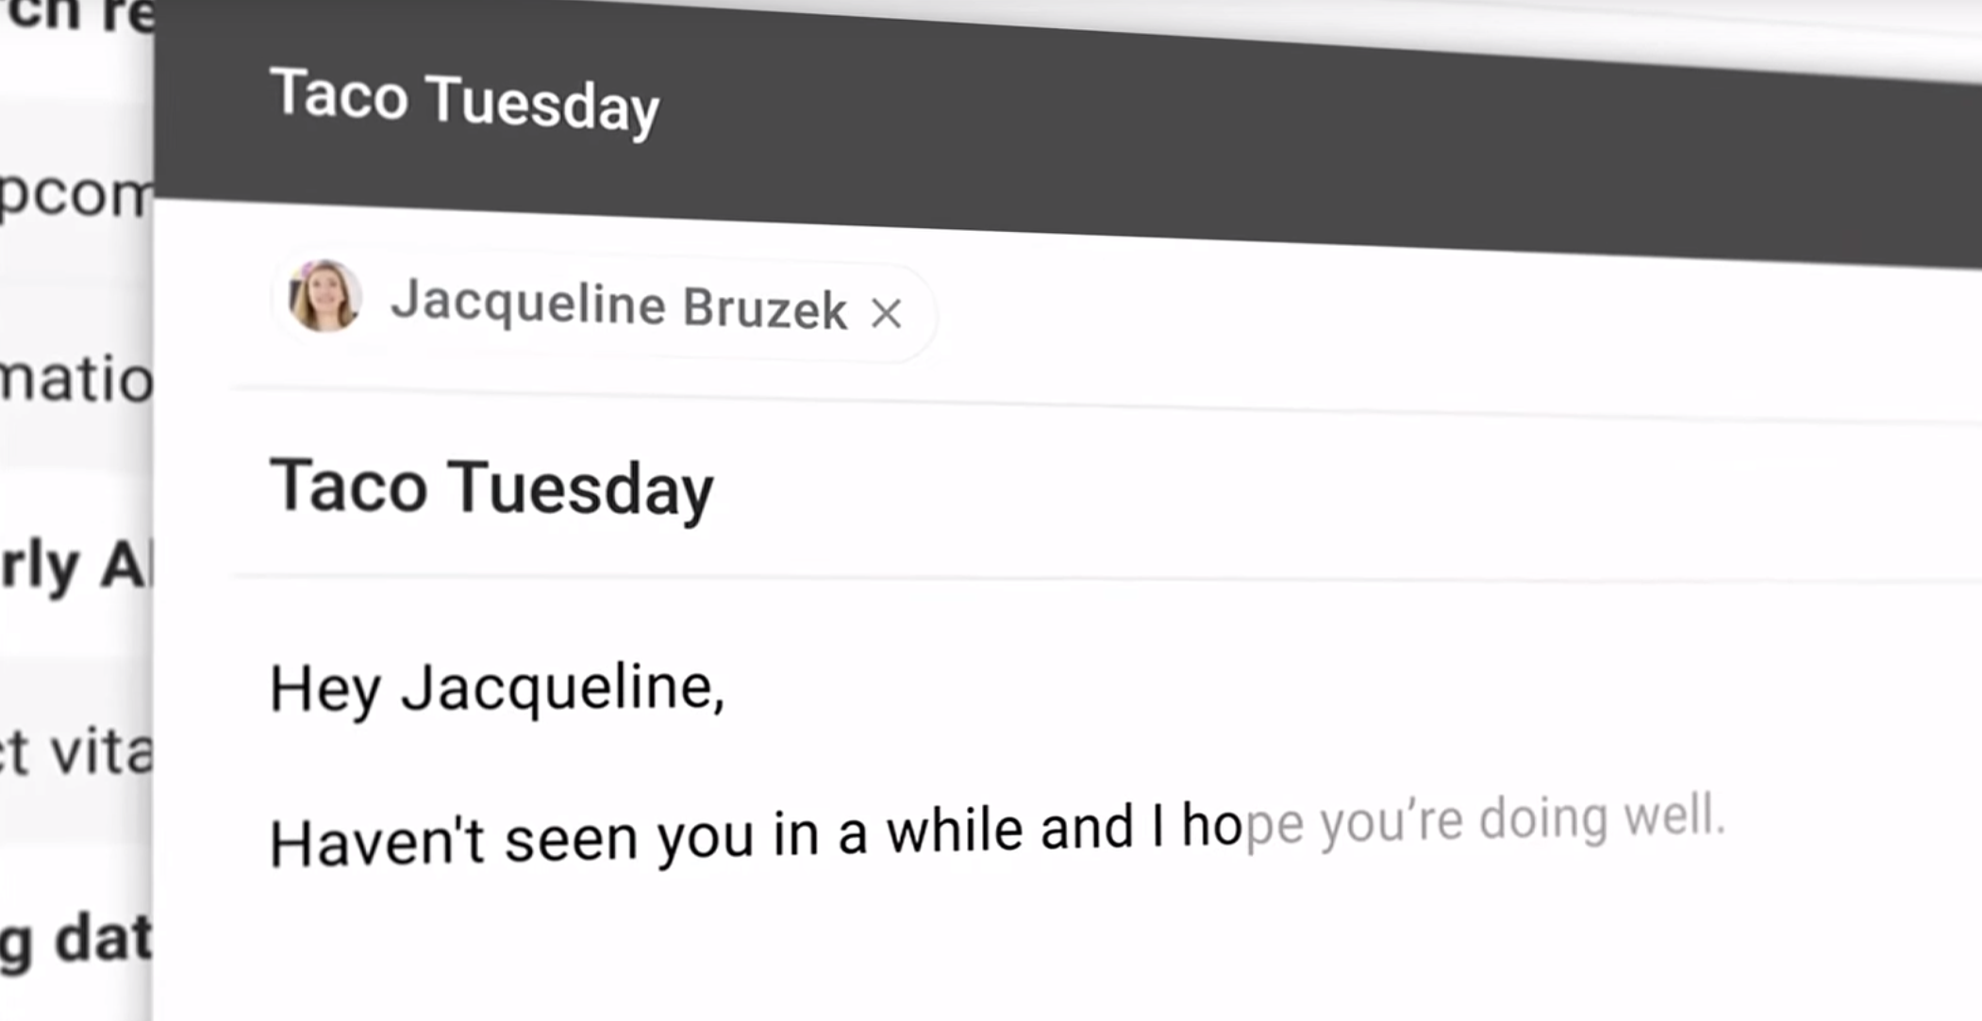

Slide 51
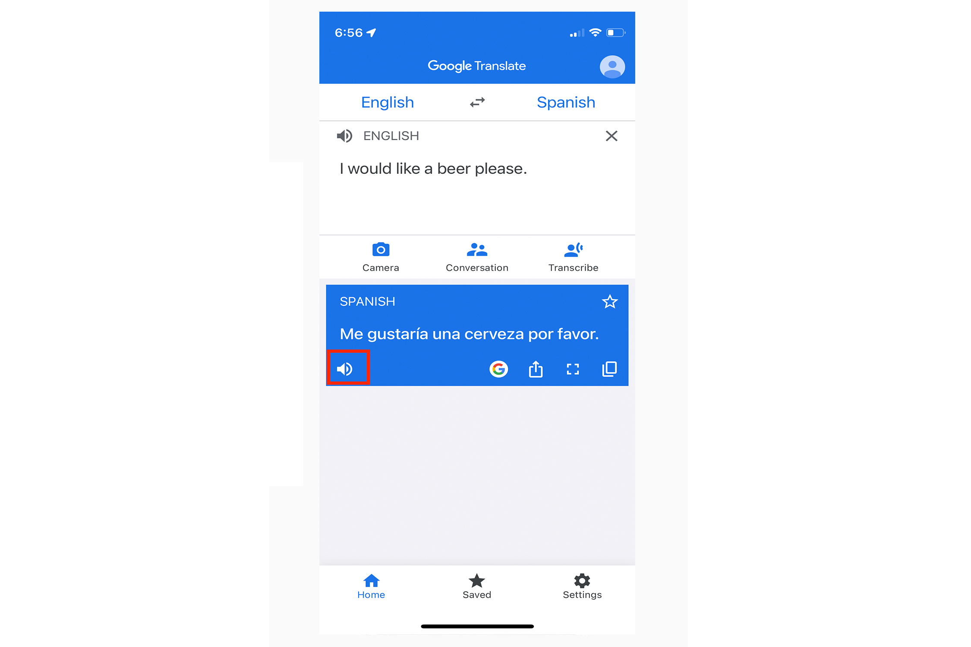

Slide 52
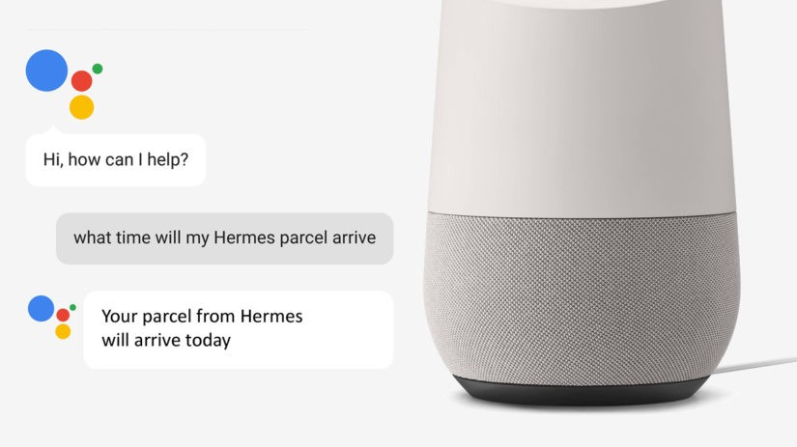

Slide 53
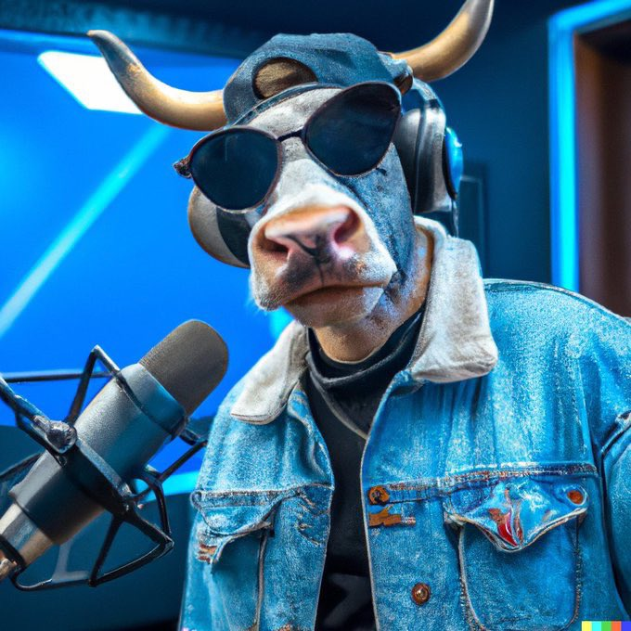
DALL-E Generation
“Photo of hip hop cow in a denim jacket recording a hit single in the studio”

Slide 54
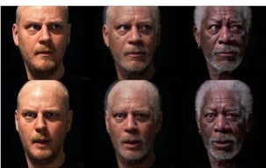
Not Morgan Freeman!
https://www.youtube.com/watch?v=oxXpB9pSETo

Slide 55

Not Morgan Freeman!

Slide 56
Course Learning Objectives
Learn about architectures that serve as foundation for tools like ChatGPT
Understand a wide range of self-supervised algorithms
Fearlessly build and train self-supervised models 😤
Gain intuitions about the capabilities and limitations of our models
Reflect on societal impacts: their misuse, biases, etc.

Slide 57
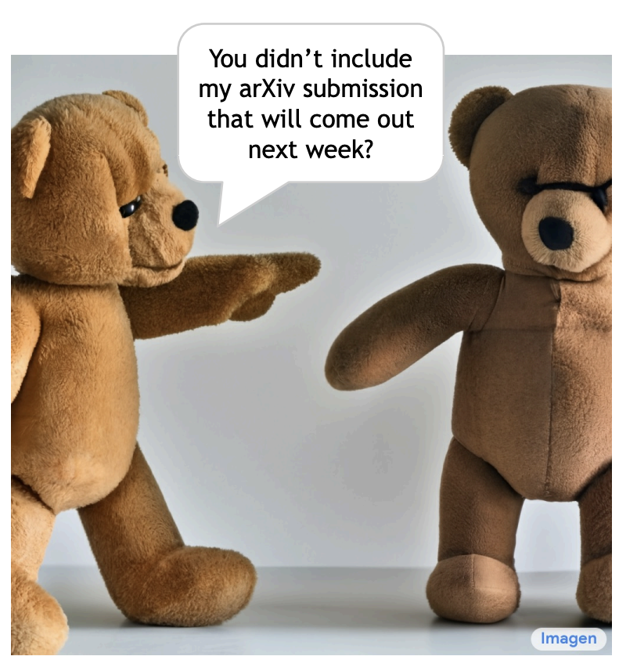
Disclaimer
We will not be exhaustive.
The goal is to give you a bird’s-eye view of the field.

Slide 58
Course Logistics
CSCI 601-471/671 (NLP: Self-Supervised Models)
https://self-supervised.cs.jhu.edu/sp2024/

Slide 59
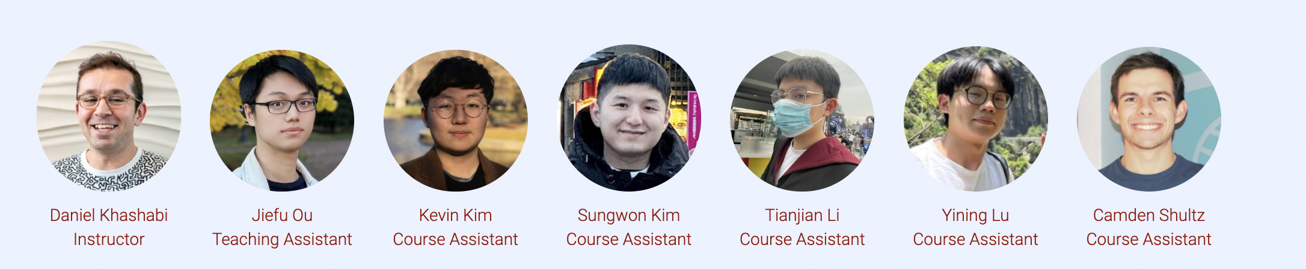
Course Logistics Brief
Instructor: Daniel Khashabi
You can call me “Daniel”, as long as we act mutually respectfully.
TA: Jiefu Ou
CAs: Kevin, Sungwon, Tianjian, Yining, Camden

Slide 60
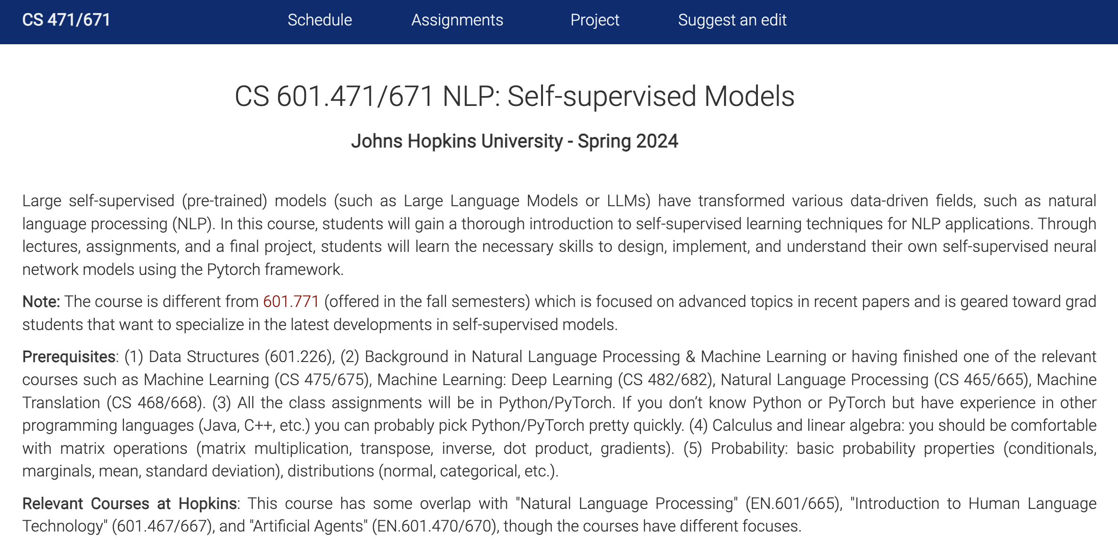
Self-Supervised Models: Course Website
https://self-supervised.cs.jhu.edu/sp2024
Notes:
Now that we have defined what ”self-supervised models” let’s what’s in this class.

Slide 61


Self-Supervised Models: Other websites

Slide 62
Course Prerequisites
Comfortable with programming, particularly Python
Calculus, linear algebra, probability
Familiarity with Natural Language Processing
HW1 should give a sense how prepared you are!

Slide 63
Course Logistics Brief
Lots of important information on the website:
https://self-supervised.cs.jhu.edu/sp2024
Syllabus, lectures, videos, tutorials, etc.
Pre-recorded videos: will be available on the course website and/or Piazza.
Office hours: regular office hours; will be announced on Piazza.
Questions or discussions: Piazza

Slide 64
Course Work and Grading Policy
Homework (team optional): 40%
7 x 1-week assignments
Midterm quizzes (individually): 30%
Final course project (team optional): 30%
Bonus points:
Extra credit questions (HW and quizzes): +10%
Helping us improve the course : +3%

Slide 65
Homework
Timeline:
Released every Tuesday and due in a week.
Each have both conceptual (theory) and empirical (coding) parts.
All assignments will be submitted to Gradescope.
Late day policy
10 free late days across all assignments; afterwards, 5% off course grade per day late
Assignments not accepted more than 7 days late (unless given permission in advance)
Collaboration policy: Allowed within certain limits:
Needs to be well-documented; acknowledge working with other students.
Avoid: copy code off the web or ChatGPT! — write your own solutions.
HW1 is released today! Due next week. Submitted via Gradescope.

Slide 66
Final Project
No HW after spring break to let you focus on your final project.
Must be exploring a topic related to the focus of the class.
This is your chance to gain research experience on a topic of interest.
Topic choice will be (relatively) free. We will help you develop your ideas!
Deliverables:
Submit project proposal outline (for our formal review and suggestions)
To make sure that the project is scoped reasonably and doable in your limited time.
Get excited 🤩 and work on the project
Midway report
Final project presentation, poster session, report

Slide 67
Attendance Policy
Not mandatory!

Slide 68
Attendance Policy
Not mandatory!
No additional grade if you attend.
However, it is highly encouraged!!
Participation in class is our chance to learn more effectively.
Come to the class and participate in the discussions!

Slide 69
Quick pulse check (1)
I am a ….:
CS major,
CS minor,
MS student,
PhD student,
studying something else

Slide 70
Quick pulse check (2)
Which one best describes you?
NLP and DL are rather new to me. Looking forward to learning more.
I am a DL, NLP or self-supervised learning enthusiast – I read casually on these topics.
I am practitioner of NLP or ML and have already worked with a variety of self-supervised models.
I am a pro. I could be part of the teaching staff of this class.

Slide 71
Quick pulse check (3)
I have read (and understood) the syllabus!
Yes
No

Slide 72
Wrapping it up!
HW1 is released!
If you’re not going to take this, drop the course!
Many are on the waitlist.

